Slide 1
OpenStack Cloud Service Console - Apna Baadal (“Our Cloud”)
Prepared by: Project Group 3

Slide 2
Introduction

Slide 3
Authors
Sagar Anil Manglani
Mahek Pavagadhi
Nolyda Tep
Nikita Mathur
Nilay Kothari
Sachet Hegde
Watsh Rajneesh

Slide 4
Objectives
To build a “Self-Service Web Portal” to provision 2 types of services:
Basic web site - create one VM with the web server.
Big web site - create 1 VM for DB and other VMs with web server.
Any provisioning error should be reported in Web UI.
Backend to use 2 ways to connect to OpenStack:
SSH
OpenStack REST APIs

Slide 5
Objectives (contd.)
To show bill of usage based on collected resource usage metrics.
To show the health of the VM and Service abstraction.

Slide 6
Architecture

Slide 7
Architecture
Oracle VM Server 3.3.3 with OpenStack Icehouse.
Following OpenStack Components are used in this project:
Nova compute
Neutron network
Glance image service
Keystone identity management service
Horizon dashboard
All OpenStack components are co-located on a single VM.

Slide 8
Architecture (Contd.)
Following configuration is used for the VirtualBox VM that will host OpenStack:
CPUs = 2
Memory = 6500MB
Network = 2 vNICs (both NAT attached)
vNIC1 – for administration of OpenStack
vNIC2 – for accessing Horizon, APIs and CLI clients.
VM configuration for provisioned VM on Oracle VM Server:
CPU = 1, Memory – 1200 MB, Network = 1 vNIC connected to a single subnet.

Slide 9
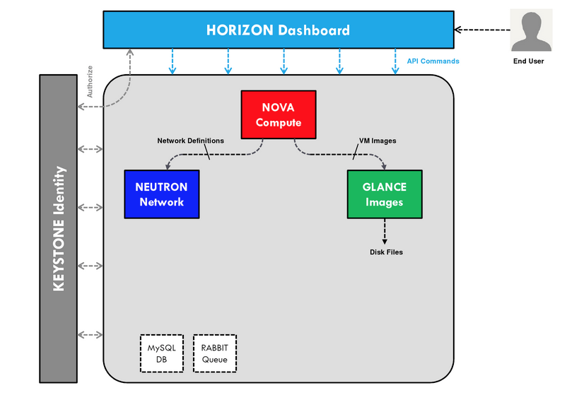
OpenStack Setup for Project

Slide 10
Technologies Used
Database - Mongo DB
OpenStack Client – OpenStack4J
Web Server – Spark Java
Web UI – Freemarker, Bootstrap, JQuery

Slide 11
Design – Middle Tier

Slide 12
Design - Overview
Web UI to create 2 service types, Basic and Big.
In the project we will pre-create the following images with Glance service:
Web Image Name = UBUNTU-WEB-IMG
DB Image Name = UBUNTU-DB-IMG
Service operations will be performed asynchronously:
Service Creation
Service Deletion
Resource usage metrics collection

Slide 13
Design - API
Following APIs are provided:
Add Service
Get Service Details
Delete Service
Get Tasks
Get Resource Usage

Slide 14
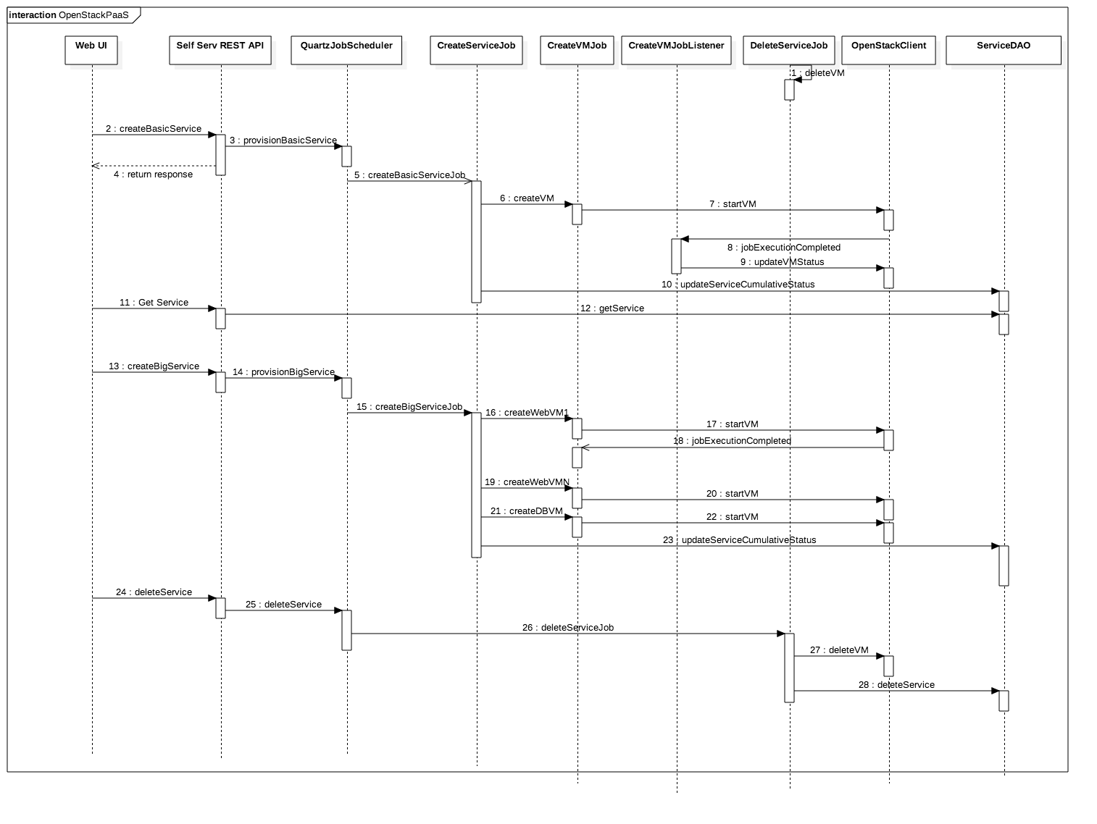
Design – API Sequence Diagram

Slide 15
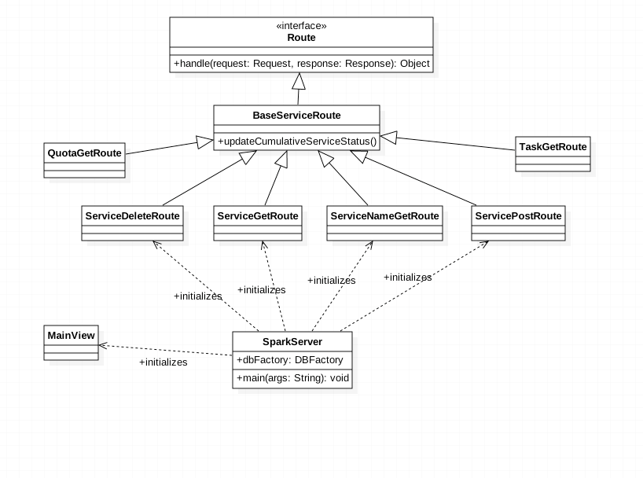
Design – Server Routes

Slide 16
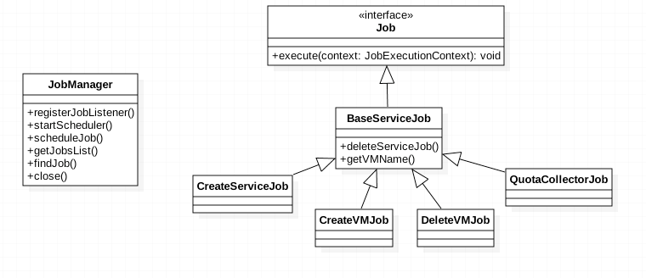
Design – Asynchronous Jobs

Slide 17
Design – Data Layer

Slide 18
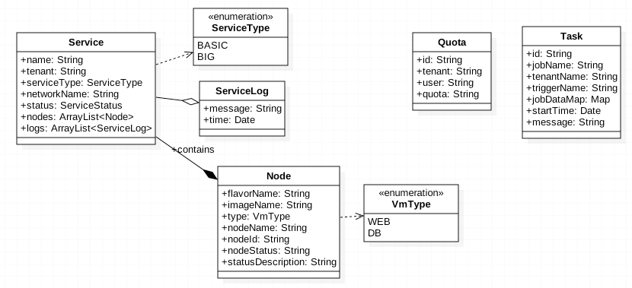
Design – Data Model

Slide 19
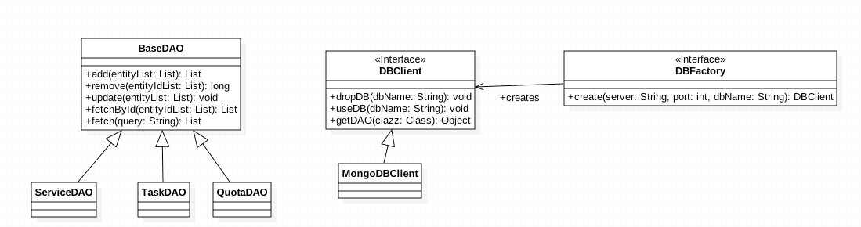
Design – Data Access Object

Slide 20
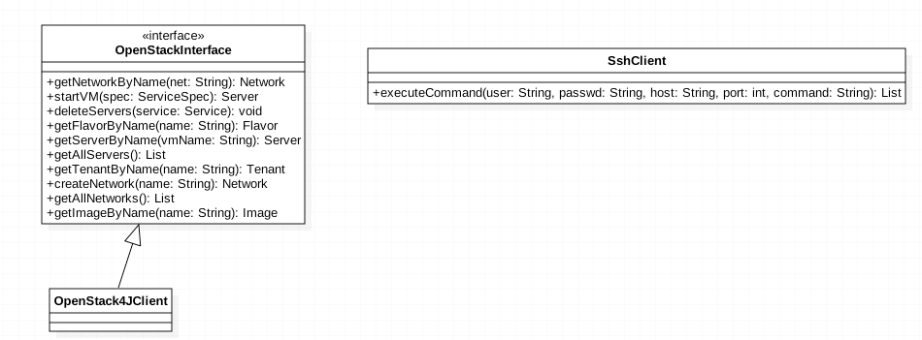
Design – OpenStack Client

Slide 21
Demo

Slide 22
Observations, Learnings and Challenges

Slide 23
Observations and Learnings
Needed to host application on OpenStack VM itself
Tried but did not use eventually the following:
OpenStack Python SDK (Setup details)
Preference went to Java; ended up using OpenStack4J.
Dropwizard web framework
Due to runtime conflicts in Jersey and Jackson dependencies for both OpenStack4J and Dropwizard, we ended up with Spark Java.

Slide 24
Challenges
No console access for VMs created via OpenStack
So only non-gui guest OS could be provisioned.
OpenStack deployment in all-in-one VM mode left very little resources for VM provisioning.
We are only able to provision 1 VM successfully.
External network access for VM provisioned on OpenStack.

Slide 25
Bibliography
OpenStack Course Slides on Canvas.
OpenStack user manual for understanding the architecture OpenStack.
OpenStack4J user manual.
Mongo DB user manual – for understanding the NoSQL DB.
Spark Java Micro Web Application Framework.
Quartz Scheduler user manual – for implementing the background processing of service request.
Freemarker Template Engine user manual – for implementing the presentation layer of the Web UI.

Slide 26
Thank You

